Slide 1
Unit 5
File Operation

Slide 2
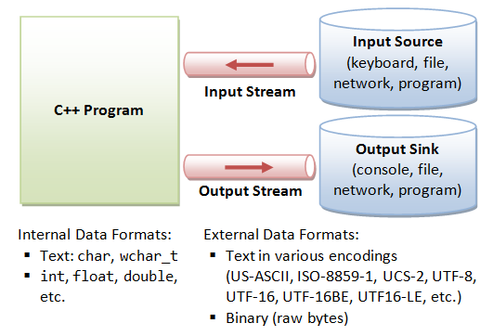
C++ Stream

Slide 3
C++ Stream
C/C++ IO are based on streams, which are sequence of bytes flowing in and out of the programs (just like water and oil flowing through a pipe).
In input operations, data bytes flow from an input source (such as keyboard, file, network or another program) into the program.
In output operations, data bytes flow from the program to an output sink (such as console, file, network or another program).
Streams acts as an intermediaries between the programs and the actual IO devices, in such the way that frees the programmers from handling the actual devices, so as to archive device independent IO operations.

Slide 4
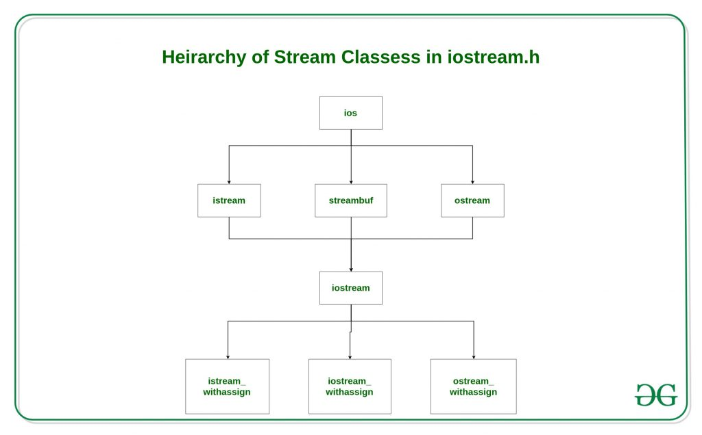
Hierachy of Stream classes in C++ (iostream.h)
ifstream
ofstream
fstream

Slide 5
In C++ there are number of stream classes for defining various streams related with files and for doing input-output operations. All these classes are defined in the file iostream.h.
ios class is topmost class in the stream classes hierarchy. It is the base class for istream, ostream, and streambuf class.
istream and ostream serves the base classes for iostream class. The class istream is used for input and ostream for the output.
Class ios is indirectly inherited to iostream class using istream and ostream. To avoid the duplicity of data and member functions of ios class, it is declared as virtual base class when inheriting in istream and ostream as
class istream: virtual public ios
{ };
class ostream: virtual public ios
{ };

Slide 6
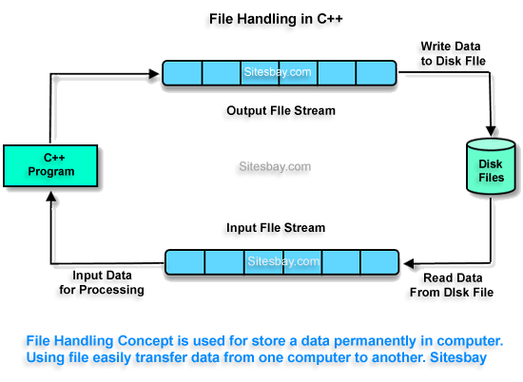
File Operations using stream

Slide 7
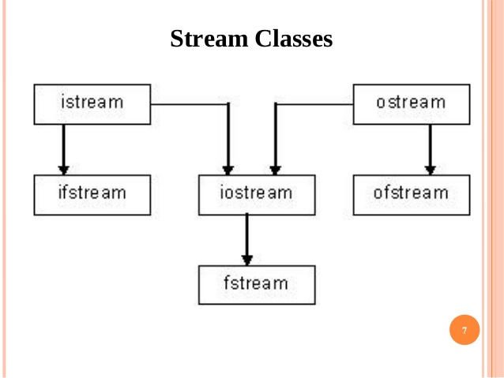
Classes for File Operations

Slide 8
Sr.No | Data Type & Description
1 | ofstream This data type represents the output file stream and is used to create files and to write information to files.
2 | ifstream This data type represents the input file stream and is used to read information from files.
3 | fstream This data type represents the file stream generally, and has the capabilities of both ofstream and ifstream which means it can create files, write information to files, and read information from files.

Slide 9
To perform input and output, a C++ program:
Construct a stream object. // iftstream fin(“input.txt”);
Connect (Associate) the stream object to an actual IO device (e.g., keyboard, console, file, network, another program).
Perform input/output operations on the stream, via the functions defined in the stream's pubic interface in a device independent manner. Some functions convert the data between the external format and internal format (formatted IO); while other does not (unformatted or binary IO).
Disconnect (Dissociate) the stream to the actual IO device (e.g., close the file). // fin.close();
Free the stream object.

Slide 10
Opening a File
A file must be opened before you can read from it or write to it. Either ofstream or fstream object may be used to open a file for writing. And ifstream object is used to open a file for reading purpose only.
Following is the standard syntax for open() function, which is a member of fstream, ifstream, and ofstream objects.
void open(const char *filename, ios::openmode mode);

Slide 11
ifstream fin(“input.doc”); // input
oftsream fout(“output.doc”); //output
fstream fin(“input.txt”,ios::in);
fstream fout(“output.txt”,ios::out);
Student s(“abc”,20);

Slide 12
Sr.No | Mode Flag & Description
1 | ios::app (append) Append mode. All output to that file to be appended to the end.
2 | ios::ate (at the end) Open a file for output and move the read/write control to the end of the file.
3 | ios::in (input) Open a file for reading.
4 | ios::out (output) Open a file for writing.
5 | ios::trunc (truncate) If the file already exists, its contents will be truncated before opening the file.
ifstream | ios::in
ofstream | ios::out
fstream | ios::in | ios::out
Default Open Modes :

Slide 13
You can combine two or more of these values by ORing them together.
Example
ofstream outfile;
outfile.open("file.dat", ios::out | ios::trunc );
OR
ofstream outfile("file.dat", ios::out | ios::trunc );

Slide 14
When a C++ program terminates it automatically flushes all the streams, release all the allocated memory and close all the opened files.
Following is the standard syntax for close() function, which is a member of fstream, ifstream, and ofstream objects.
void close();

Slide 15
int rn;
cin >> rn // cin istream – keyboard
String msg =“Hello”
cout << msg; // cout ostream - screen
Cout << rn;
ifstream fobj(“input.txt”);
char ch;
fobj >> ch;
String msg =“Hello”;
ofstream fobj1(“output.txt”);
fobj1 << msg;

Slide 16
Writing to a File
While doing C++ programming, you write information to a file from your program using the stream insertion operator (<<) just as you use that operator to output information to the screen.
The only difference is that you use an ofstream or fstream object instead of the cout object.
Reading from a File
You read information from a file into your program using the stream extraction operator (>>) just as you use that operator to input information from the keyboard. The only difference is that you use an ifstream or fstream object instead of the cin object.

Slide 17
Opening/creating a file
#include<iostream>
#include <fstream>
using namespace std;
int main()
{
fstream new_file;
new_file.open("new_file.txt",ios::out);
cout<<"New file created";
new_file.close();
}
return 0;
}

Slide 18
Writing to File
#include <iostream>
#include <fstream>
using namespace std;
int main(){
fstream new_file;
new_file.open("new_file_write.txt",ios::out);
cout<<"New file created";
new_file<<"Learning File handling"; //Writing to file
new_file.close();
}
return 0;
}

Slide 19
Reading from file
#include <iostream>
#include <fstream>
using namespace std;
int main()
{
fstream new_file;
new_file.open("new_file_write.txt",ios::in);
if(!new_file) {
cout<<"No such file";
}
else {
char ch;
while (!new_file.eof()) // eof() function returns true or false value depending on the position of file pointer
{
new_file >> ch;
cout << ch;
}
new_file.close();
return 0;
}

Slide 20
Special operations in a File
There are few important functions to be used with file streams like:
tellp() - It tells the current position of the put pointer. Syntax: filepointer.tellp()
tellg() - It tells the current position of the get pointer. Syntax: filepointer.tellg()
seekp() - It moves the put pointer to mentioned location. Syntax: filepointer.seekp(no of bytes,reference mode)
seekg() - It moves get pointer(input) to a specified location. Syntax: filepointer.seekg((no of bytes,reference point)
put() - It writes a single character to file.
get() - It reads a single character from file.
For seekp and seekg three reference points are passed: ios::beg - beginning of the file ios::cur - current position in the file ios::end - end of the file

Slide 21
Program for filecopy
Int main(){
Char msg;
Ofstream out;
Out.open(“file1.txt”);
Ifstream in;
In.open(“file2.txt”);
While(! In.eof())
{
in >> msg;
out << msg;
}
Cout << “File copied”;
Out.close().
In.close();

